Slide 1


CyberHealth
Final Project Delivery and Demonstration
CEN4010 - Fall 2021
Team members
Nha Tran
(Product Owner and Backend developer)
Nelly Delgado Planche
(Scrum Master and Frontend developer)
Huy Nguyen
(Scrum Master and Frontend developer)

Slide 2
Overview
Why
COVID-19 pandemic and other future variances
Staff and other resources shortages in hospitals
Avoid exposure, prefer online services
Moderate to mild symptoms can be treated at home under physician supervision
What
CyberHealth is an online platform that offers health monitoring services exclusively for Covid patients.
How
Our priority is provide a fast, easy to use, and quality product to connect doctors and patients.

Slide 3
System Implementation Infrastructure
Languages: HTML, CSS, PHP, and JavaScript
Platform: Jira, Github, phpMyAdmin, Lamp Server, Bootstrap, and WhatsApp.
DB Organization:
Admin (id, username, password)
Doctor (id, username, password, firstName, lastName, email, gender, birthday, phone, address, insuranceAccept, licenseNum)
Patient (id, username, password, firstName, lastName, email, gender, birthday, phone, address, insuranceNum, diagnose, status, description, medication_bool, medication, allergy_bool, allergy, doctor_assign)
Prescription (id, doctor_username, patient_username, comment, medication, pharmacy, pharm_address, pharm_phone, quantity, strength, note, date)
Message (id, patient_username, doctor_username, comment, date)

Slide 4

Functionalities
Non-member:
Browse the main homepage
Create an account
Member:
Sign in
Edit Profile
View page
Manage as an Admin
Manage as a Doctor
Manage as a Patient

Slide 5
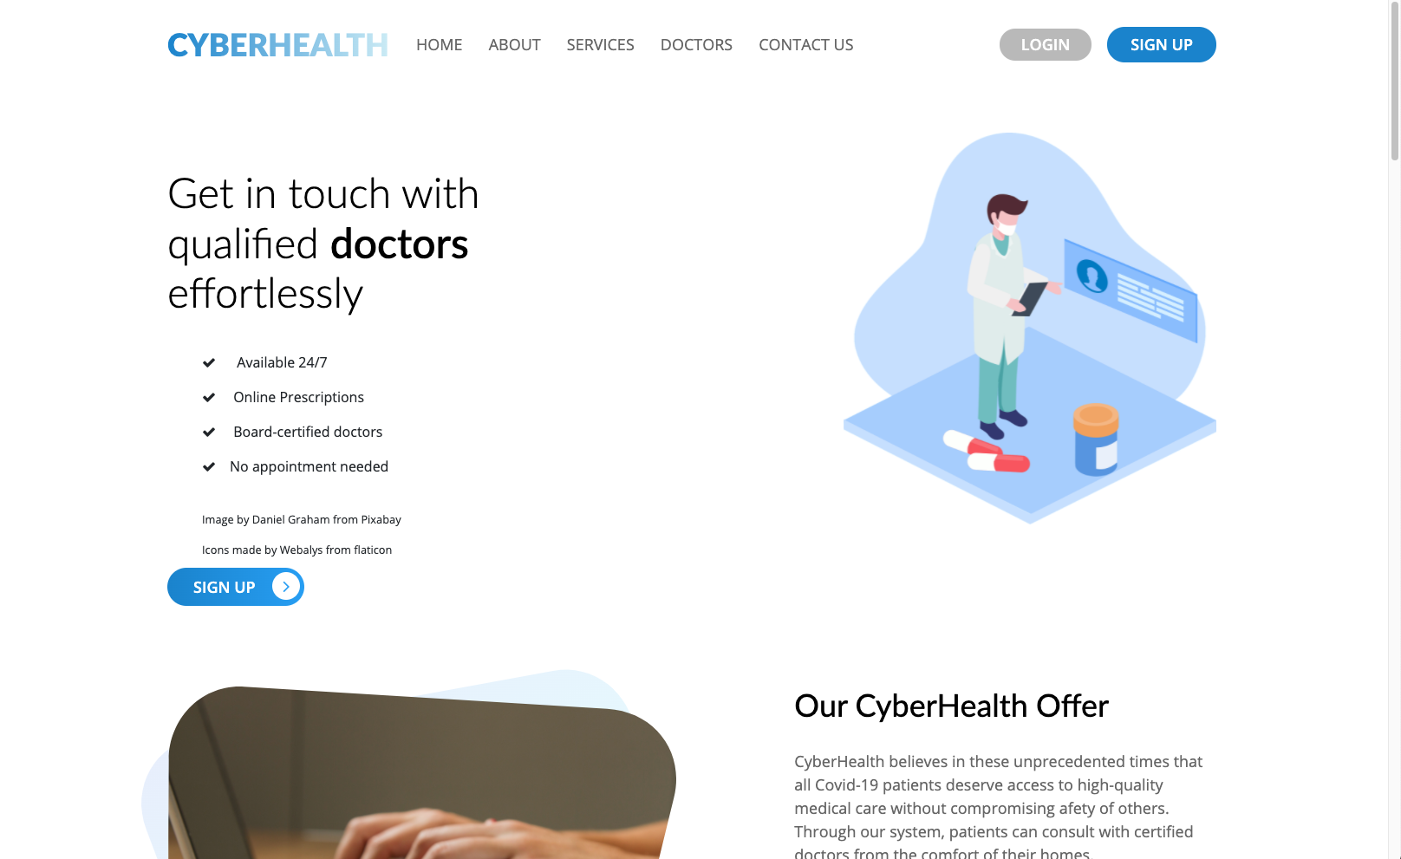
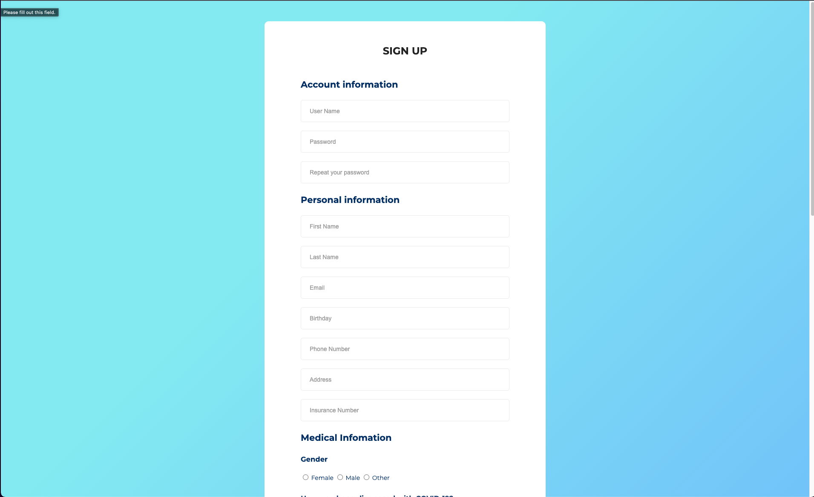
Non-member Functionalities (Finished)
Browse the main homepage
Create an account

Slide 6
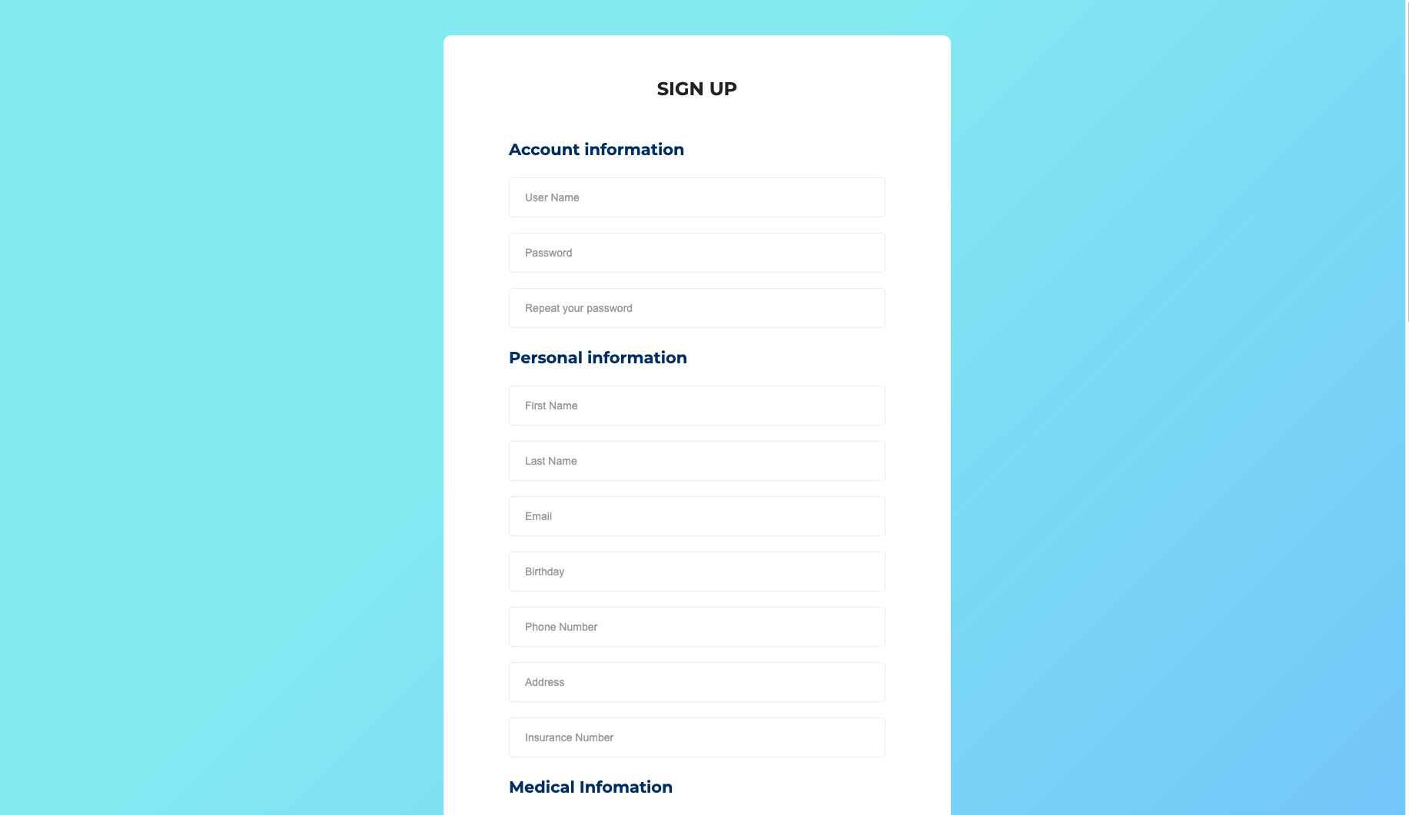
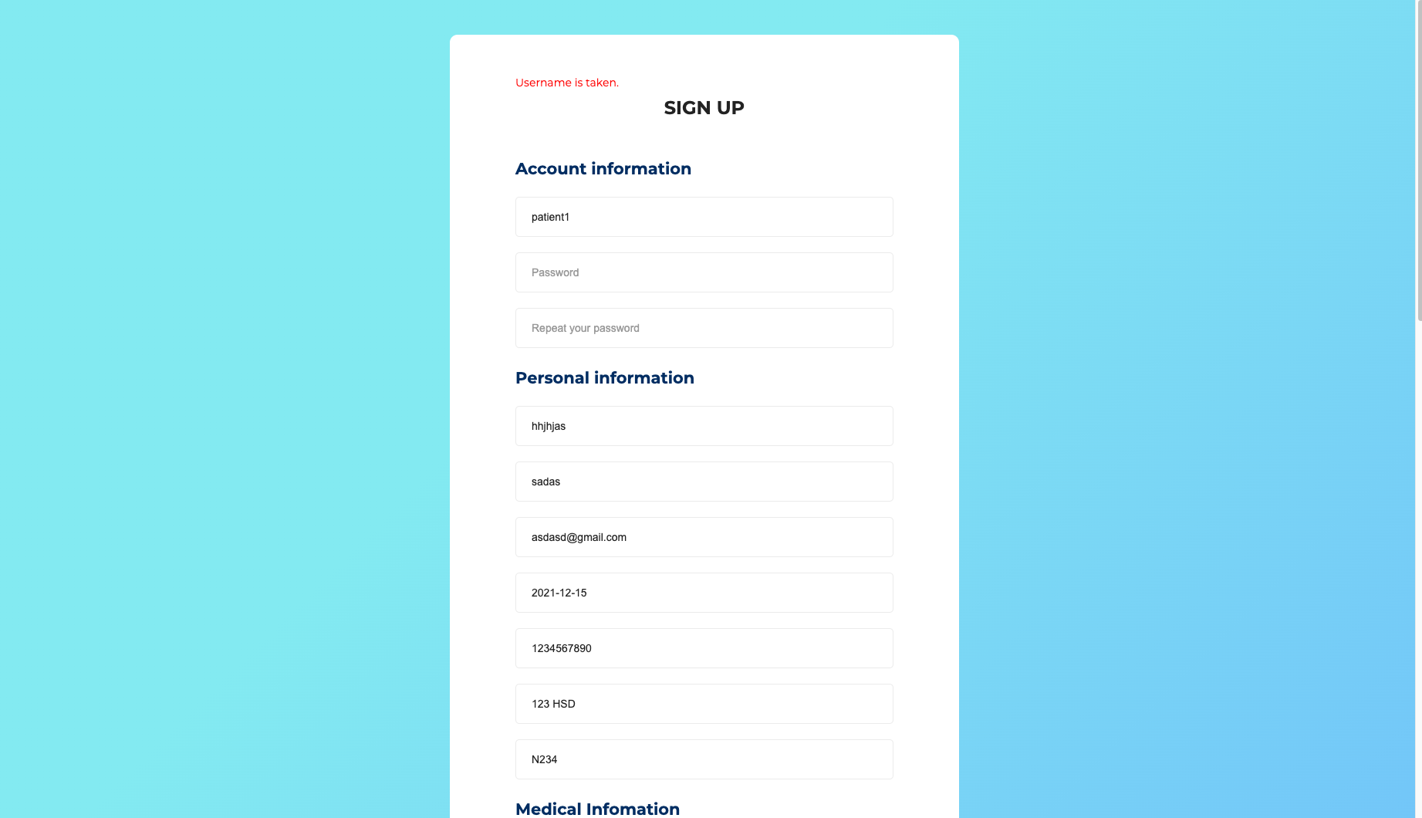
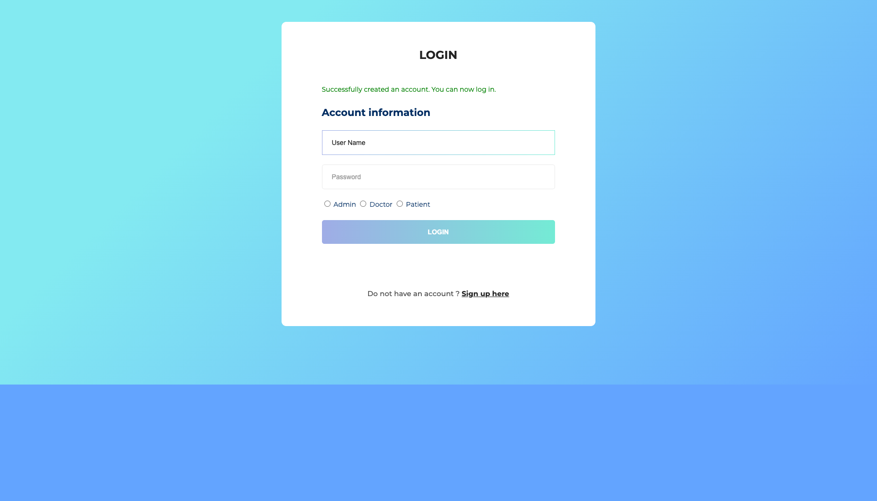
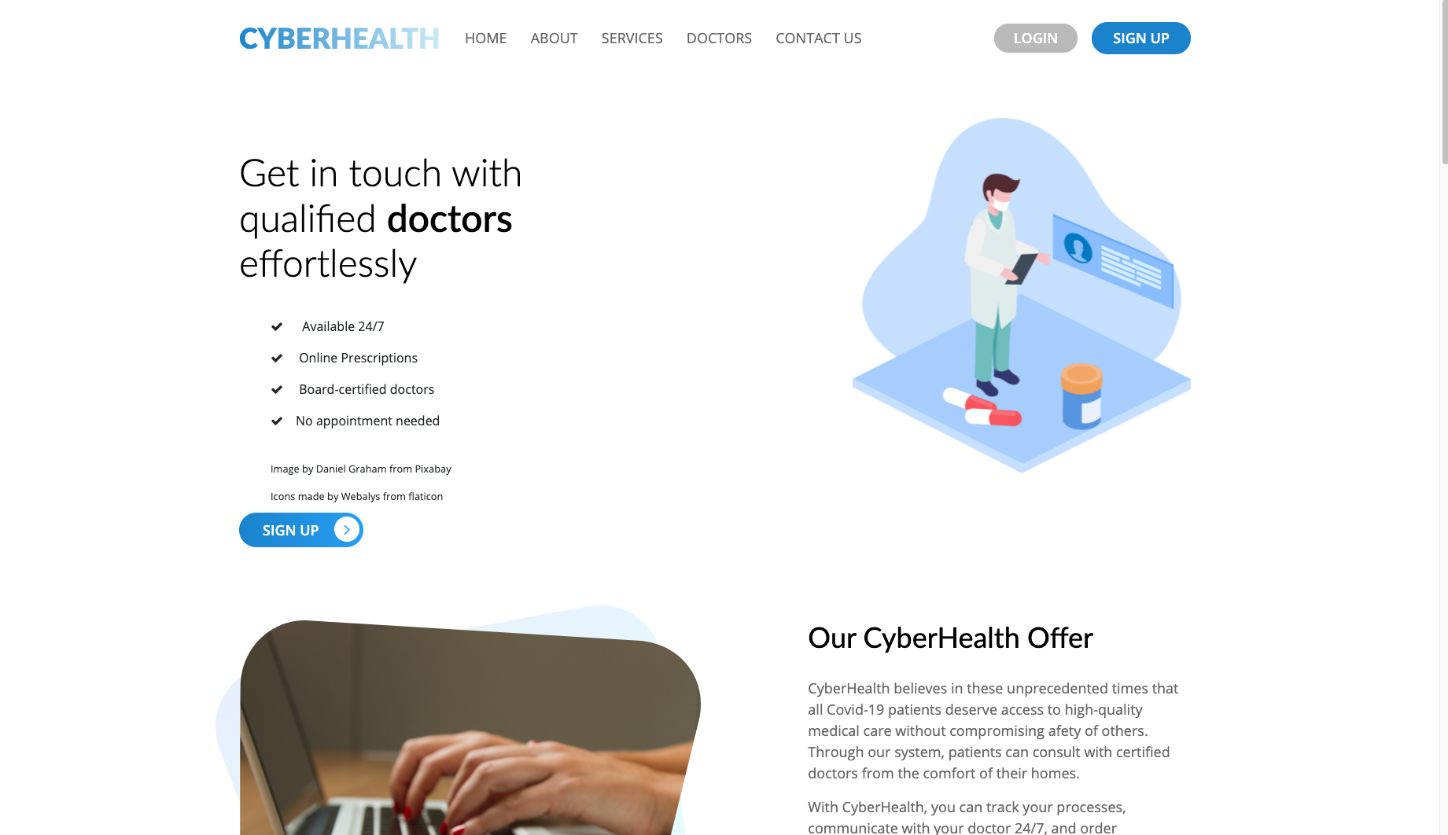
Screenshots for Non-member

Slide 7
Member Functionalities - Manage as an Admin (Finished)
Sign in
See a list of Doctors and Patient
Delete Doctor or Patient
Edit Doctor or Patient’s Profile
Add new Doctor or Patient

Slide 8
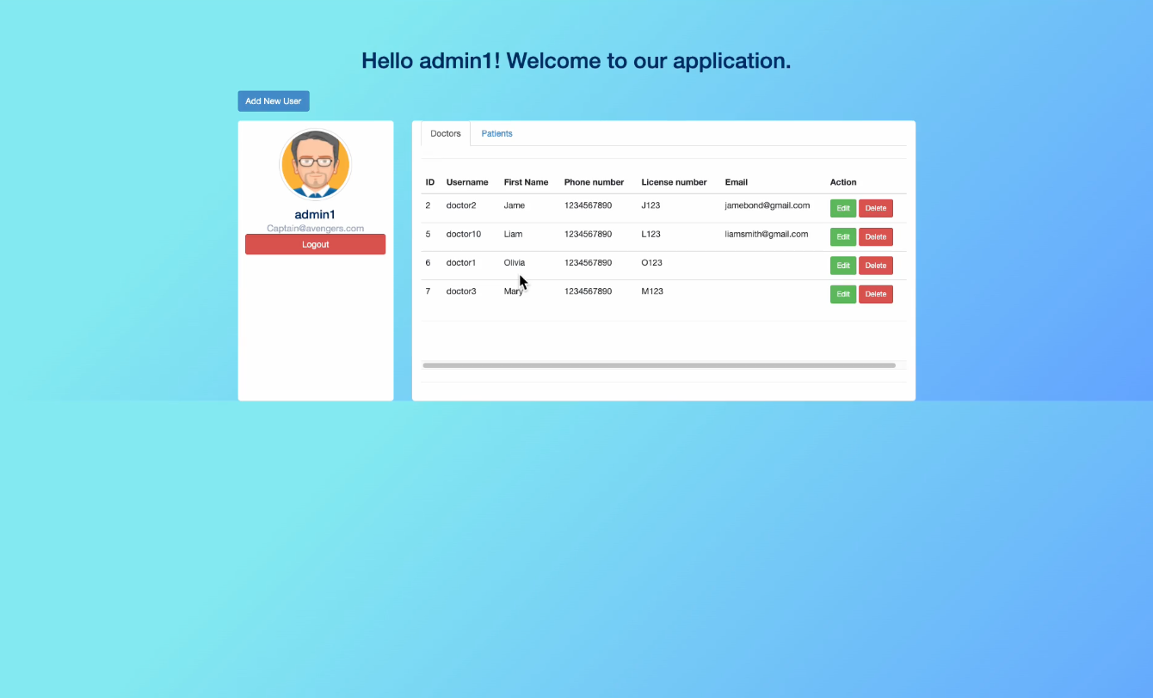
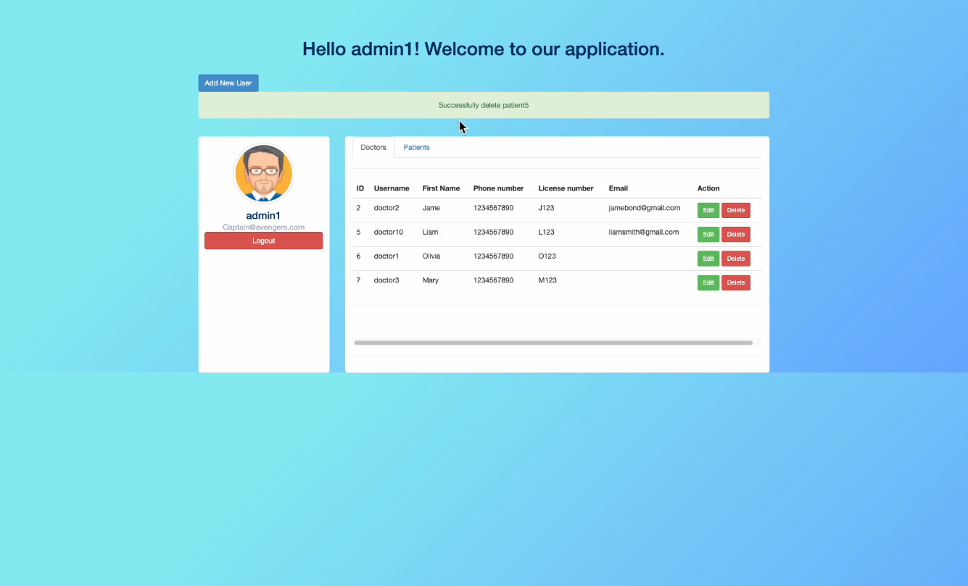
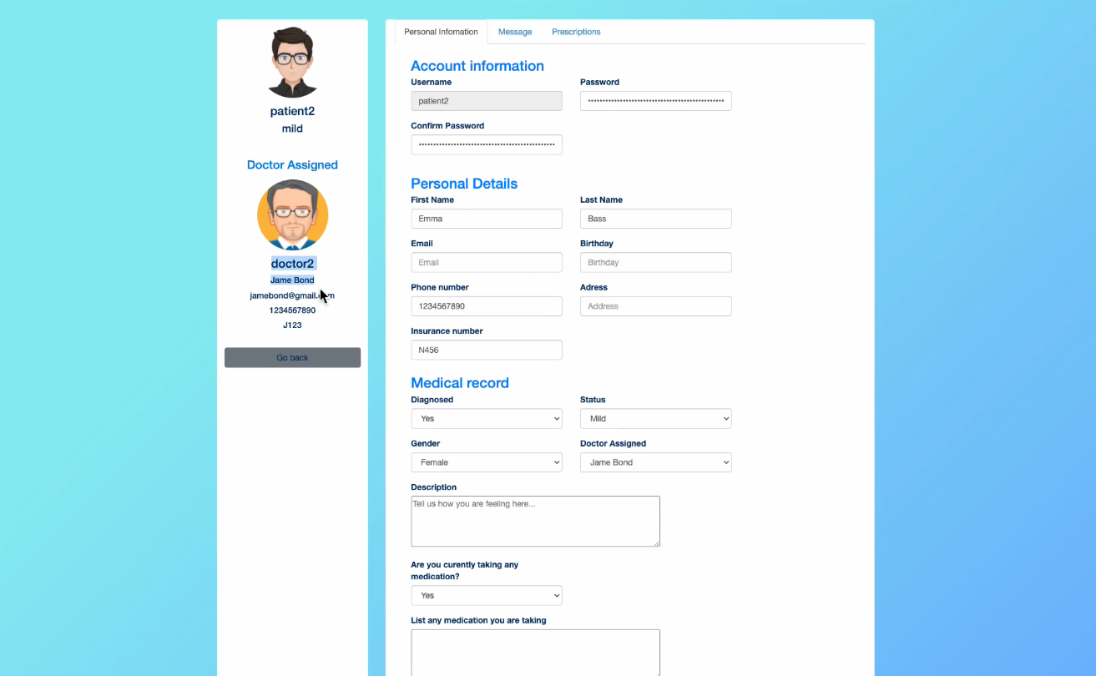
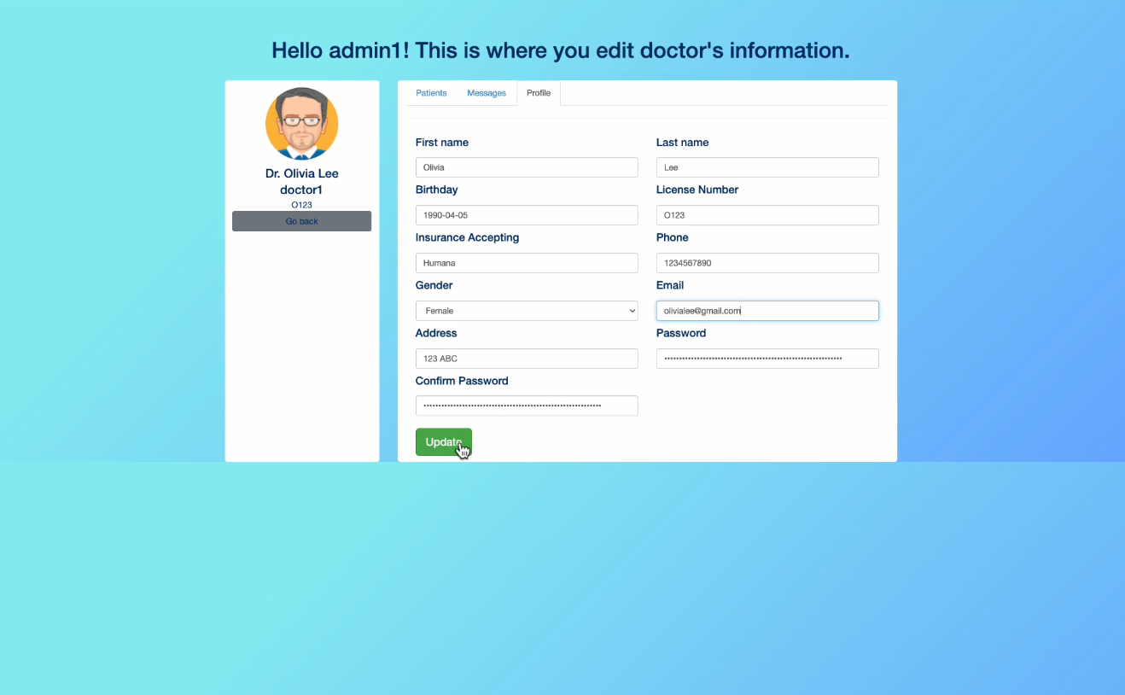
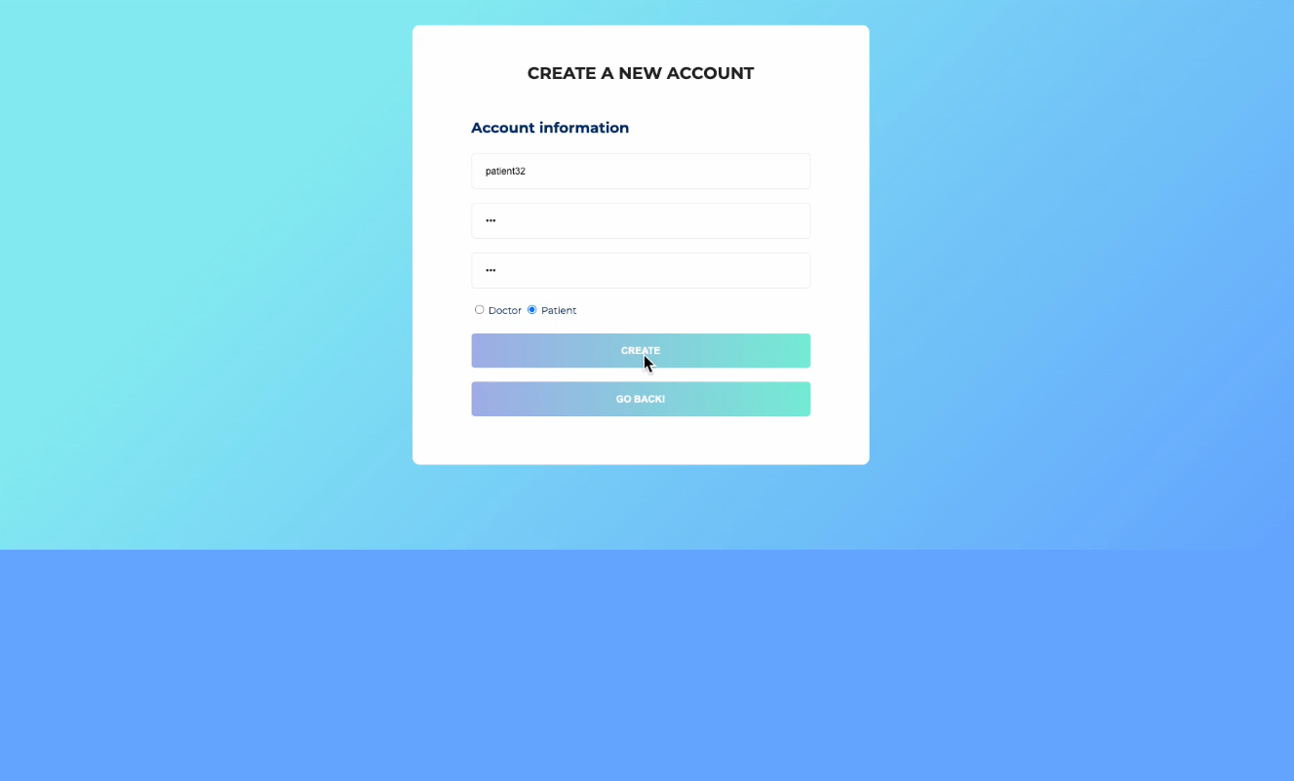
Screenshots - Manage as Admin

Slide 9
Member Functionalities - Manage as an Doctor (Finished)
Sign in
Edit their own profile
See a list of Patient
Edit Patient’s Profile
Add a prescription to Patient
See previous prescriptions
See messages from Patient

Slide 10
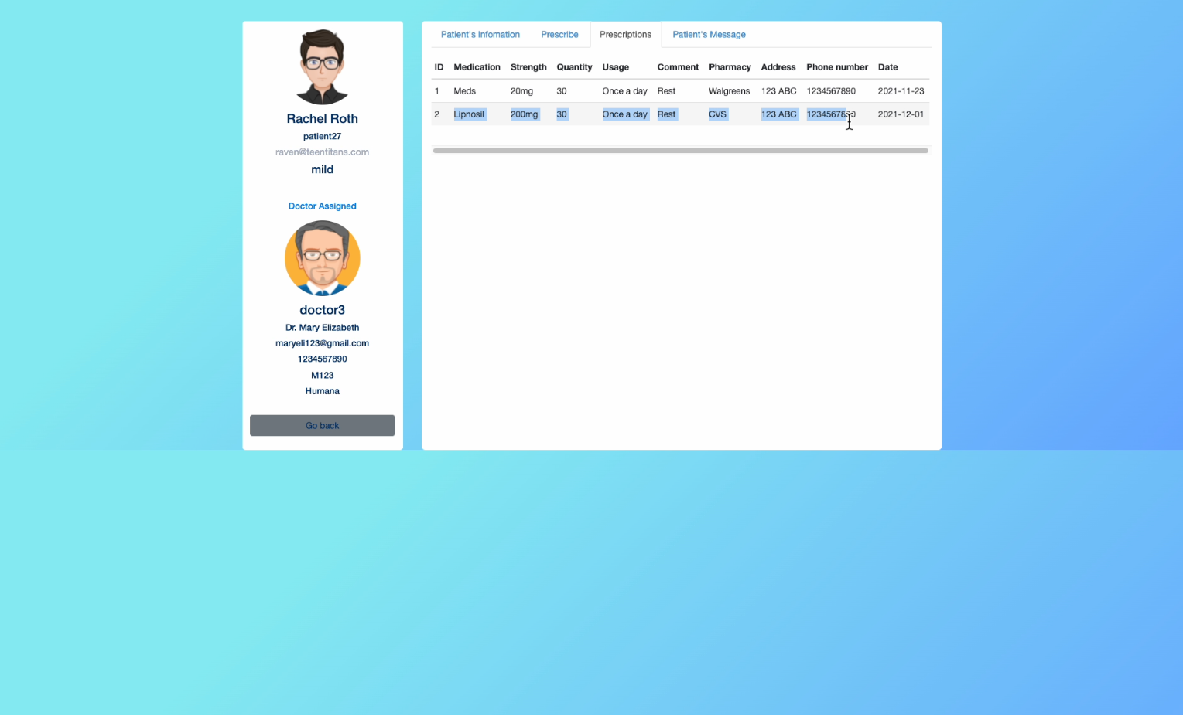
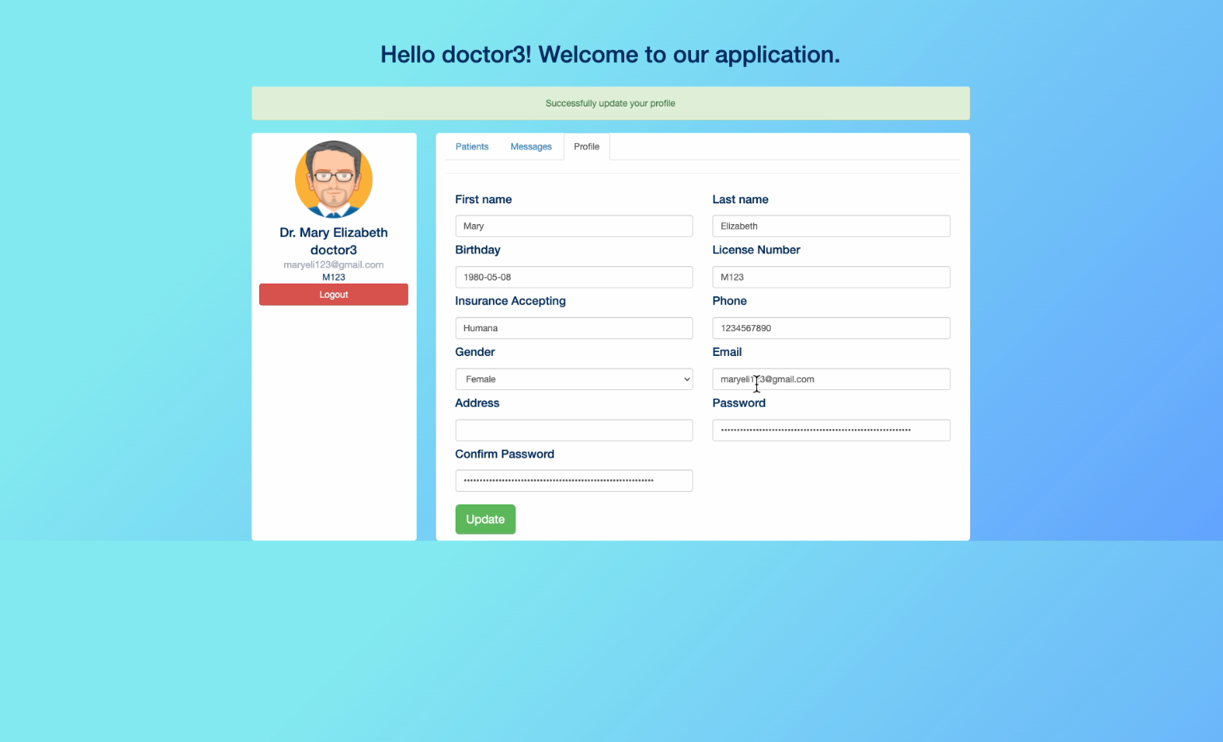
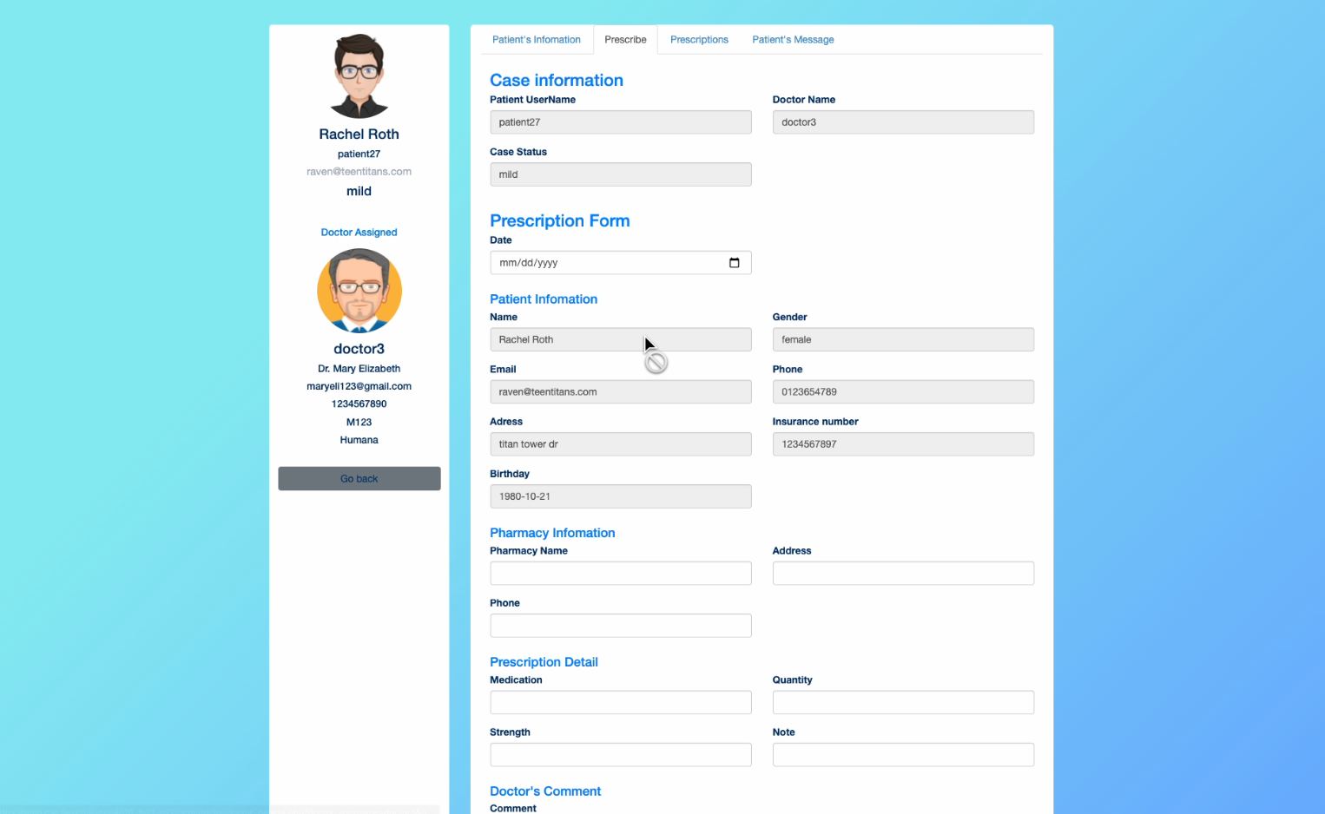
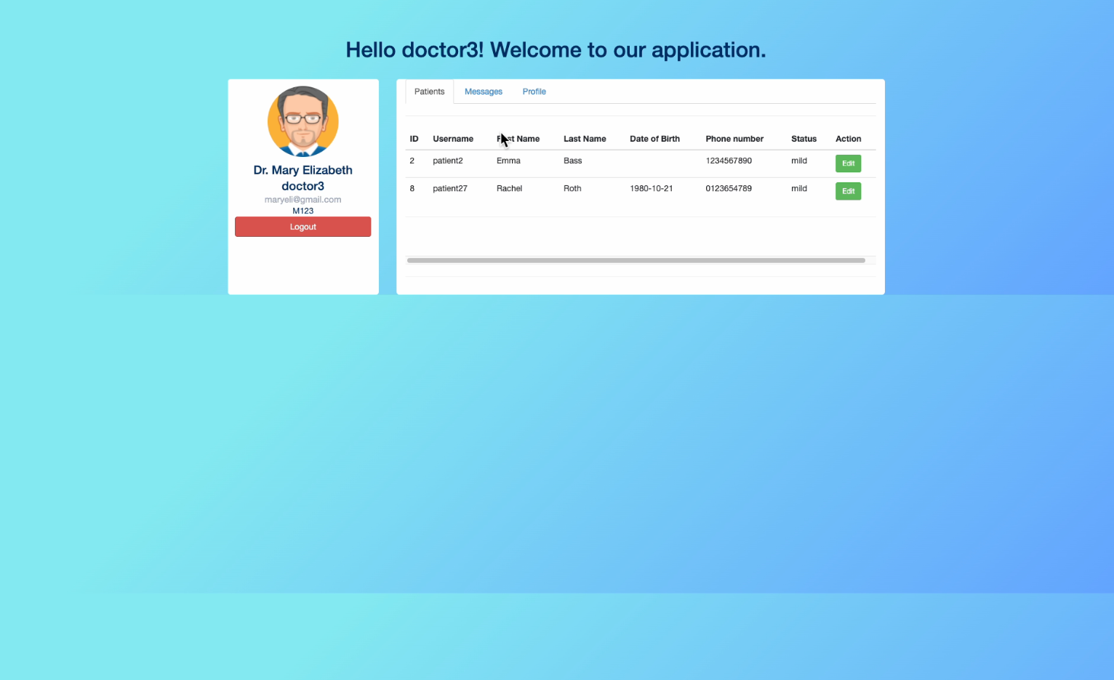
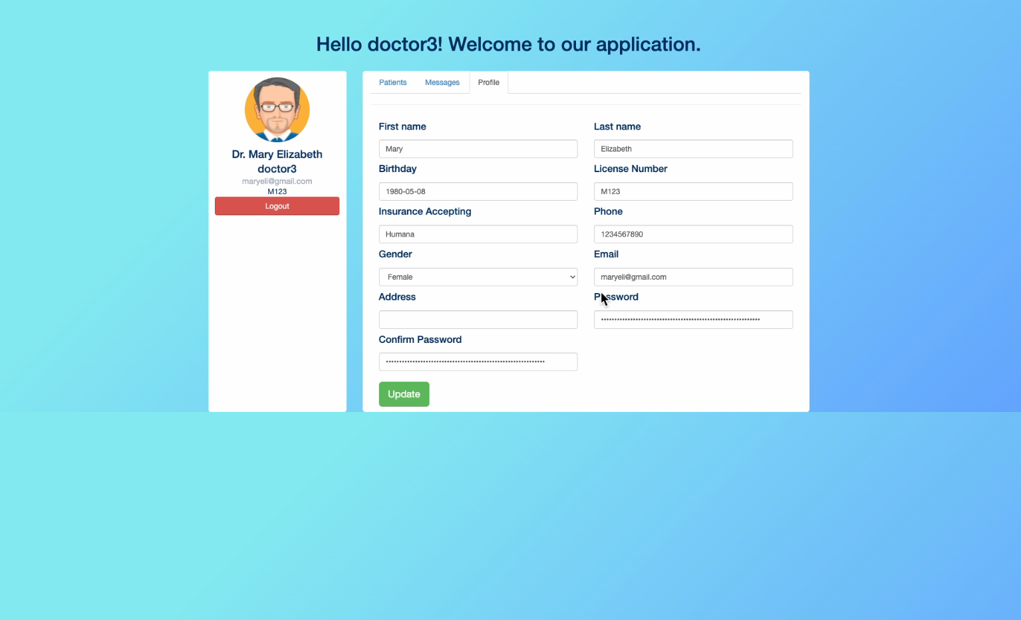
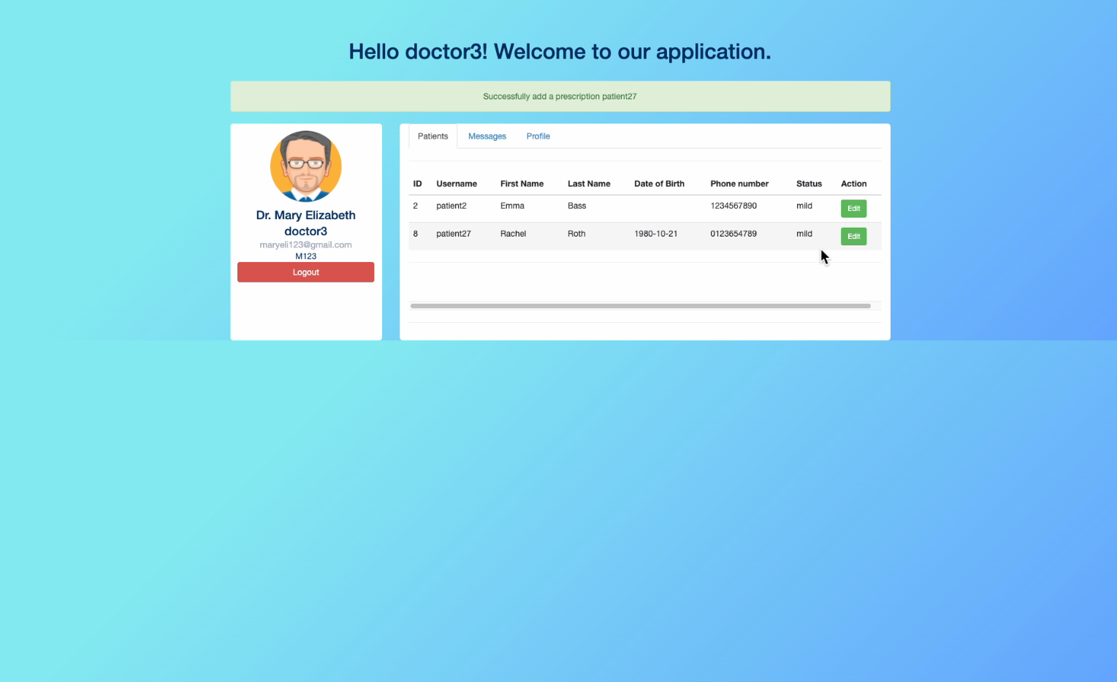
Screenshots - Manage as an Doctor

Slide 11
Member Functionalities - Manage as an Patient (Finished)
Sign in
Edit their own profile
See their assigned doctor
See prescriptions that doctor assigned to them
Send doctor a message
See their previous messages sent to Doctor

Slide 12
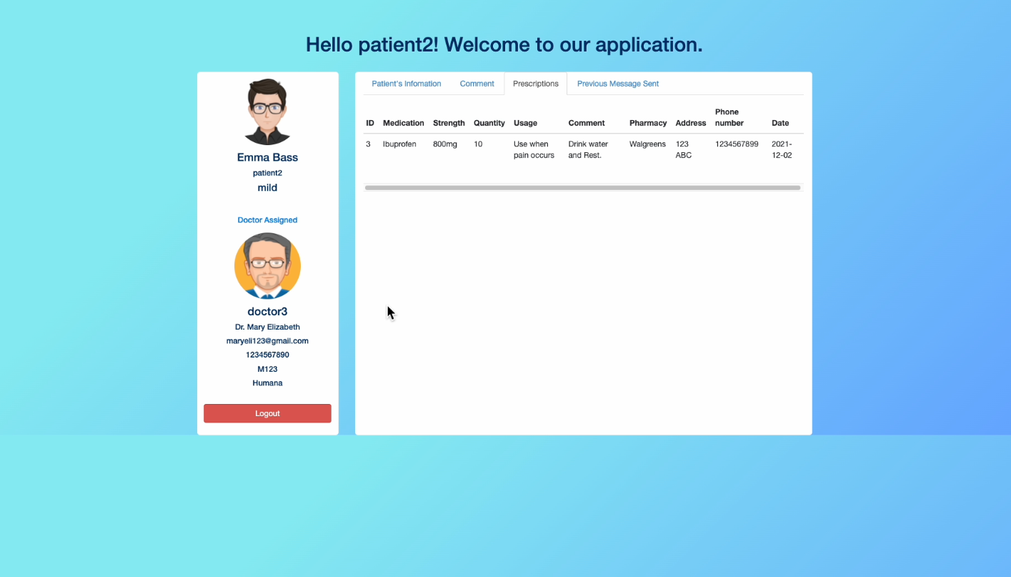
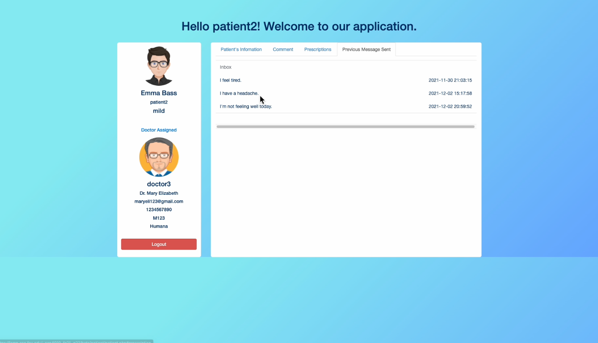
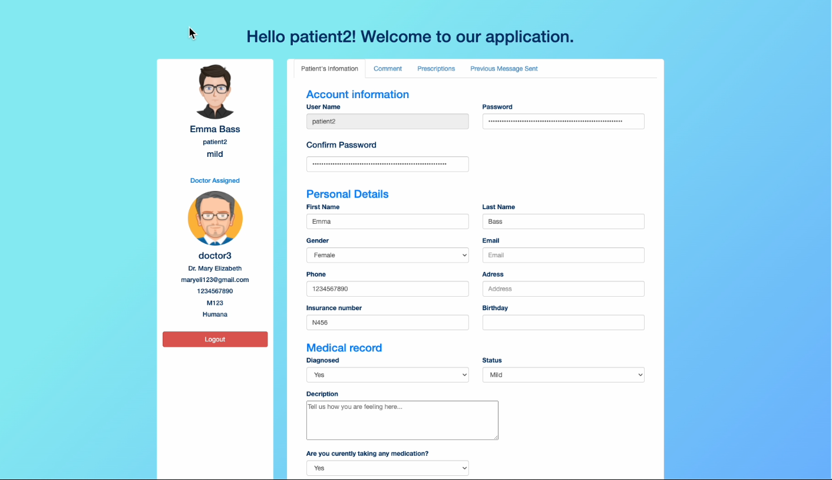
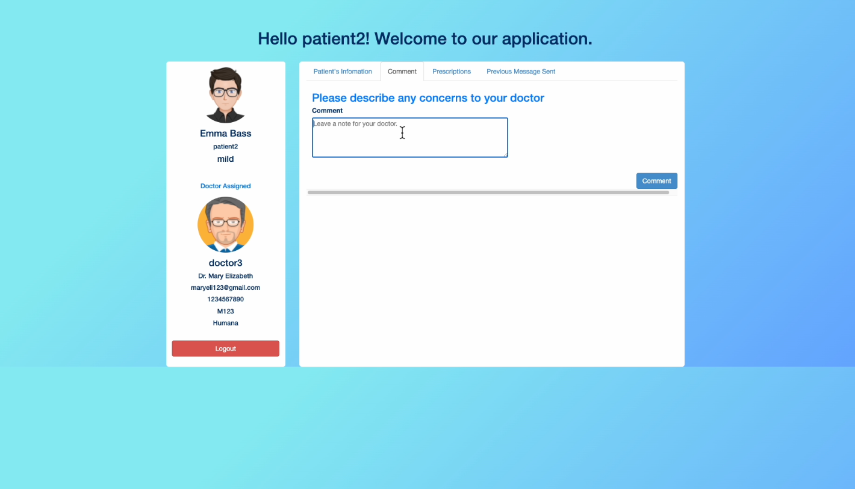
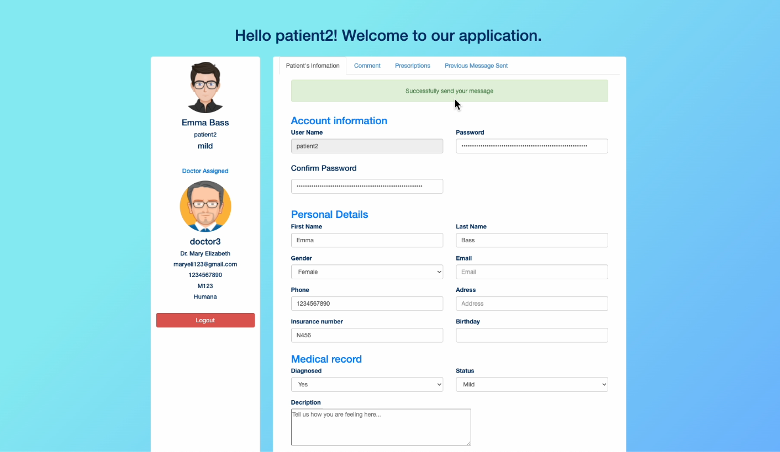
Screenshots - Manage as an Patient

Slide 13
Non-functional requirements
Performance: loading time should not exceed 1 second for users
Reliability: users can access the website 98% of the time without failure
Recoverability: Recovery time should not exceed three days for major problems and eight hours for minor ones
Storage: The storage of our system will use lamp.cse.fau.edu server holding our mySQL databases
Expected Load: Our system is expected to make allowances for up to 50 users at the same time
Security: Only admin can view doctors and patients’ information. Only doctors can view a patient's medical record
Compatibility: the website must work on multiple browsers (chrome, safari, etc.) and devices (tablet, phone, laptop, etc.)
Usability: the website must be user-friendly and prioritize user experience
Data integrity: the system must keep all doctors and patient data secure and fully back-up for every record
Easy to use: the website should be easy to use to any users, even in their first visiting.

Slide 14
Lesson learned and Desired features
Lesson
The actual process of creating a software product.
The important tools for software development.
Starting earlier when find team members.
Working as a team and time management.
Consult with professor to discuss the required knowledge and skills for the project
Desired Features
Doctor can sign up and verify their identity by uploading proofs
A function that can automatically match doctors with patients based on their insurance and working time
Improve the UI
Learn about Ajax

Slide 15
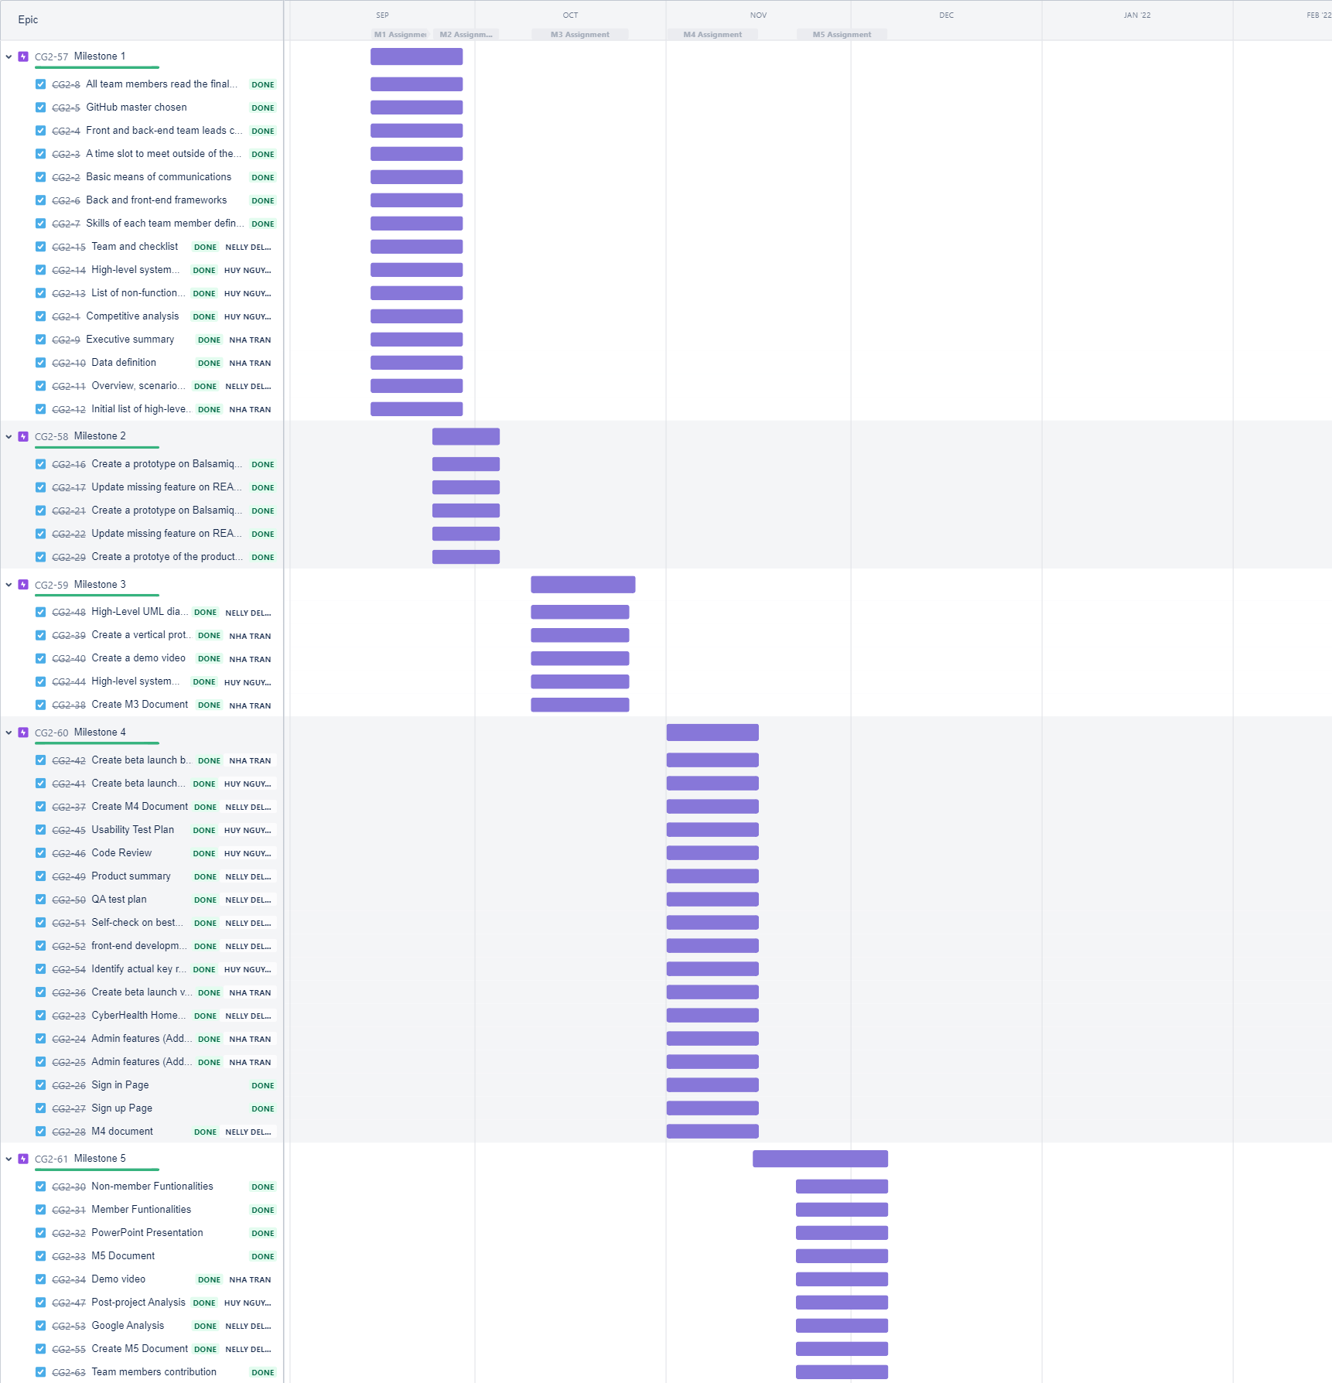
Jira workspace

Slide 16
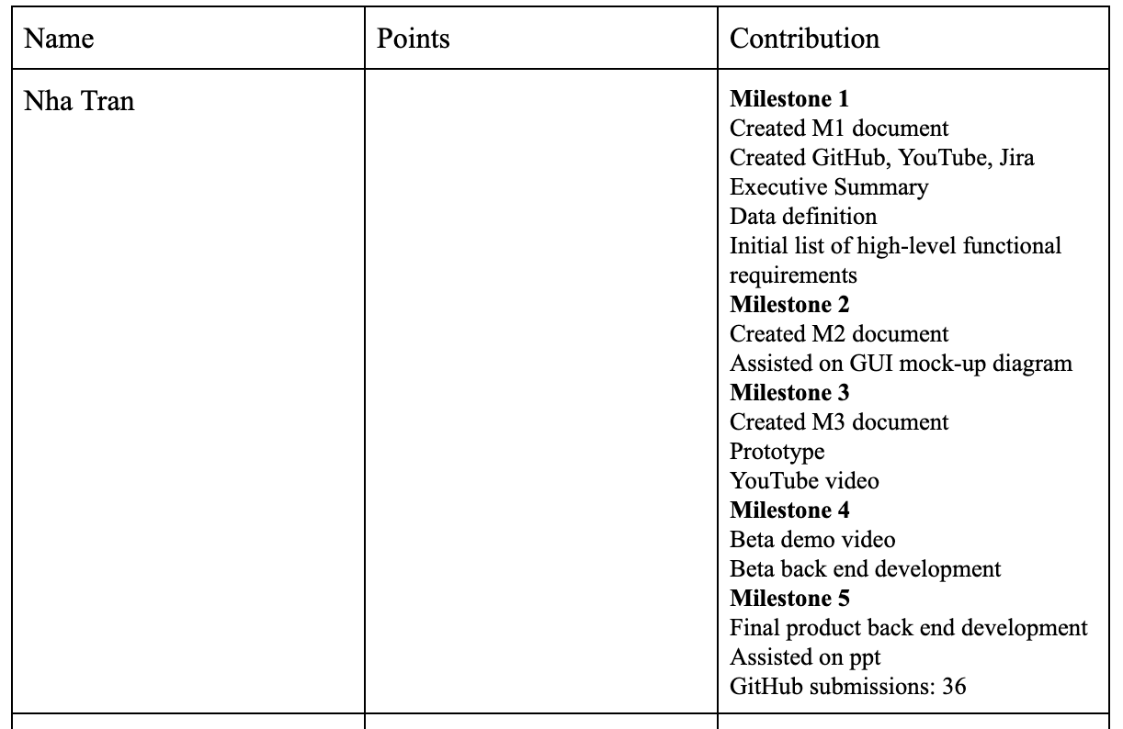
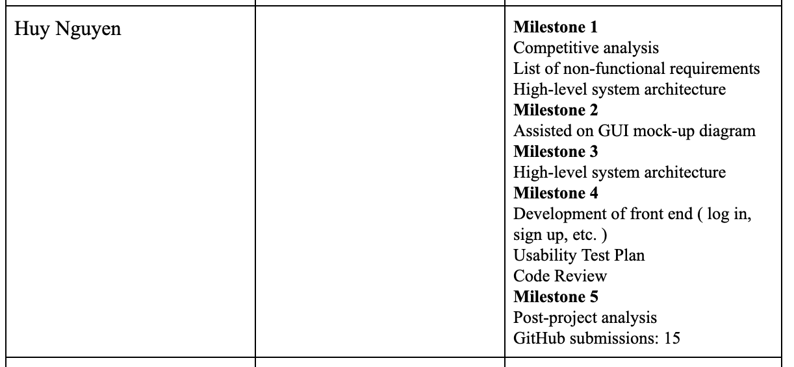
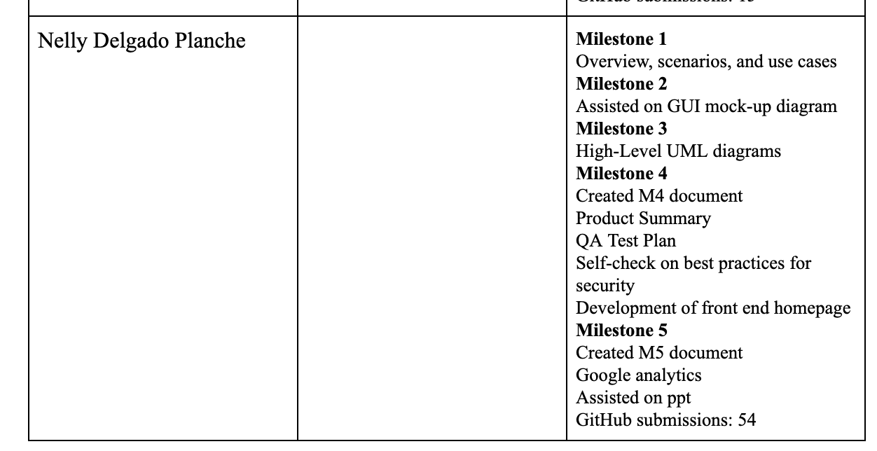
Member’s contribution

Slide 17
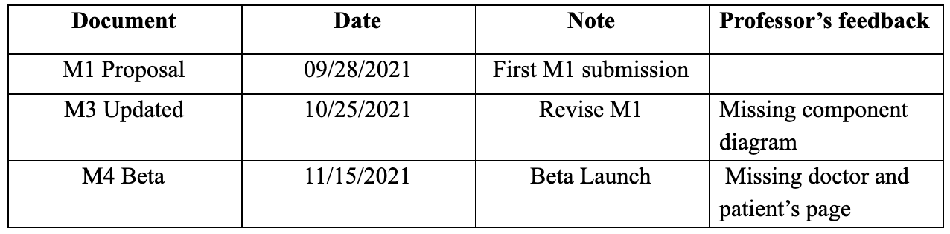
Revision Table

Slide 18

Demo video for all the functionalities
URL: https://lamp.cse.fau.edu/~cen4010_fa21_g22/beta
PowerPoint Presentation + Demo: https://youtu.be/D_a5tMiiDfk
Demo only: https://youtu.be/2hJty_mFT5c

